Slide 1
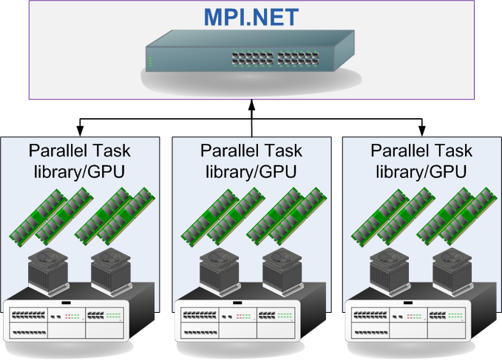
MPI.NET
Supercomputing in .NET using the Message Passing Interface
David Ross
Email: willmation@gmail.com
Blog: www.pebblesteps.com
Notes:
Good evening.
My name is david ross and tonight I will be talking about the Message Passing Interface which is a high speed messaging framework used in the dvelopment of software on Supercomputers. Due to the commodisation of hardware and

Slide 2
Computationally complex problems in enterprise software
ETL load into Data Warehouse takes too long. Use compute clusters to quickly provide a summary report
Analyse massive database tables by processing chunks in parallel on the computer cluster
Increasing the speed of Monte Carlo analysis problems
Filtering/Analysis of massive log files
  Click through analysis from IIS logs
  Firewall logs

Slide 3
Three Pillars of Concurrency
Herb Sutter/David Callahan break parallel computing techniques into:
Responsiveness and Isolation Via Asynchronous Agents
  Active Objects, GUIs, Web Services, MPI
Throughput and Scalability Via Concurrent Collections
  Parallel LINQ, Work Stealing, Open MP
Consistency Via Safely Shared Resources
  Mutable shared Objects, Transactional Memory
Source - Dr. Dobb’s Journal
http://www.ddj.com/hpc-high-performance-computing/200001985
Notes:
Before I go discuss MPI it is very important when discussing concurrency or parallel programming that we understand the problem space the technology is trying to solve. Herb Sutter who runs the C++ team at Microsoft has broken the multi-core currency problem into 3 aspects. Isolated components, Concurrent collections and safety. MPI falls into the first bucket and is focussed on high speed data transfer between compute nodes.

Slide 4
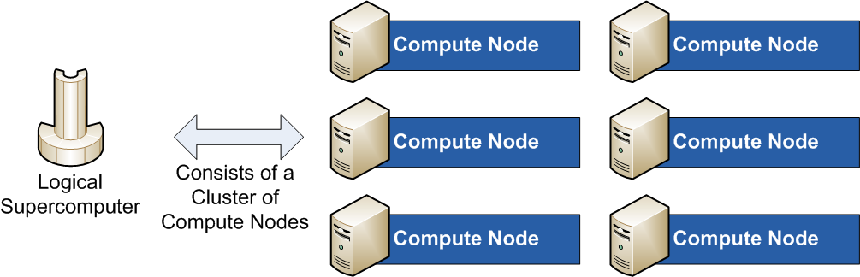
The Logical Supercomputer
Supercomputer:
Massively Parallel Machine/Workstations cluster
Batch orientated: Big Problem goes in, Sometime later result is found...
Single System Image:
Doesn’t matter how the supercomputer is implemented in hardware/software it appears to the users as a SINGLE machine
Deployment of a program onto 1000 machines MUST be automated
Notes:
Assuming we have a problem that is too slow to run under a single process or single machine. We have the problem of orchestrating data transfers and commands between the nodes.

Slide 5
Message Passing Interface
C based API for messaging
Specification not an implementation (standard by the MPI Forum)
Different vendors (including Open Source projects) provide implementations of the specification
MS-MPI is a fork (of MPICH2) by Microsoft to run on their HPC servers
  Includes Active Directory support
  Fast access to the MS network stack
Notes:
MPI is an API standard not a product and there are many different implementations of the standard. MPI.NET meanwhile uses knowledge of the .NET type system to remove the complexity of using MPI from a language like C. In C u must explicitly state the size of collections and the width of complexity types being transferred. In MPI.NEY the serialisation is far easier.

Slide 6
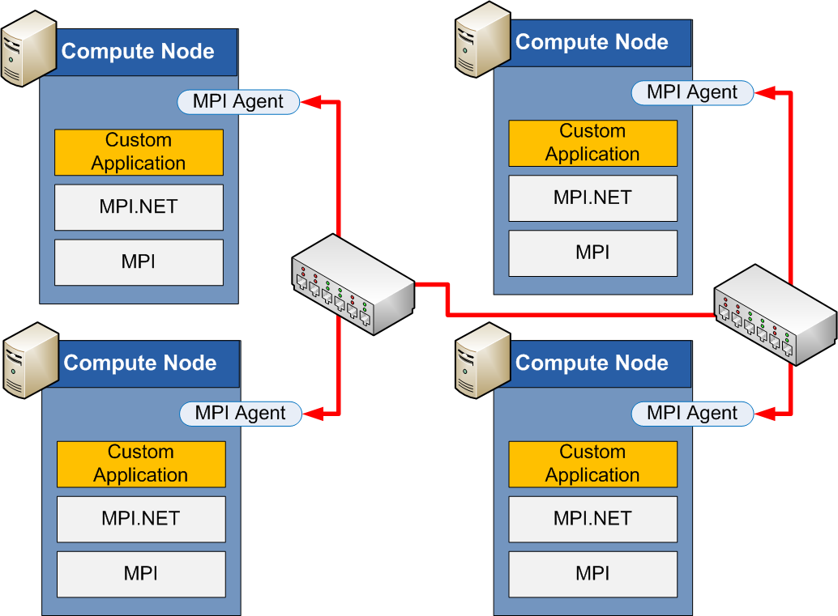
MPI Implementation
Standard defines:
Coding interface (C Header files)
MPI Implementation is responsible for:
Communication with OS & hardware (Network cards, Pipes, NUMA etc...)
Data transport/Buffering

Slide 7
MPI
Fork-Join parallelism
  Work is segmented off to worker nodes
  Results are collated back to the root node
No memory is shared
  Separate machines or processes
  Hence data locking is necessary/impossible
Speed critical
  Throughput over development time
Large data orientated problems
  Numerical analysis (matrices) are easily parallelised

Slide 8
MPI.NET
MPI.Net is a wrapper around MS-MPI
MPI is complex as C runtime can not infer:
  Array lengths
  the size of complex types
MPI.NET is far simpler
  Size of collections etc inferred from the type system automatically
  IDispose used to setup/teardown MPI session
MPI.NET uses “unsafe” handcrafted IL for very fast marshalling of .Net objects to unmanaged MPI API
Notes:
As we will see in the code examples later MPI.NET is a

Slide 9
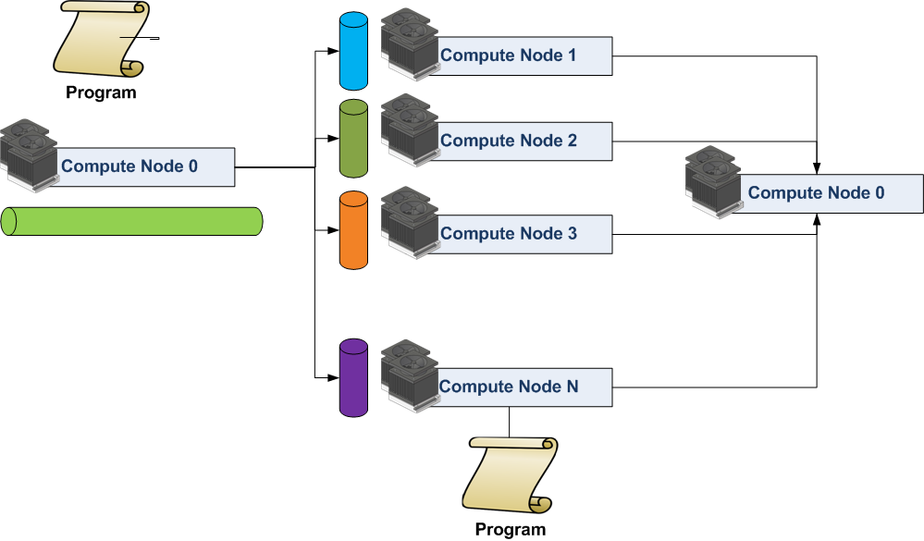
Single Program Multiple Node
Same application is deployed to each node
Node Id is used to drive application/orchestration logic
Fork-Join/Map Reduce are the core paradigms

Slide 10
Hello World in MPI
public class FrameworkSetup {
static void Main(string[] args) {
using (new MPI.Environment(ref args)) {
string s = String.Format(
"My processor is {0}. My rank is {1}",
MPI.Environment.ProcessorName,
Communicator.world.Rank);
Console.WriteLine(s);
}
}
}

Slide 11
Executing
MPI.NET is designed to be hosted in Windows HPC Server
MPI.NET has recently been ported to Mono/Linux - still under development and not recommended
Windows HPC Pack SDK
mpiexec -n 4 SkillsMatter.MIP.Net.FrameworkSetup.exe
    My processor is LPDellDevSL.digiterre.com. My rank is 0
    My processor is LPDellDevSL.digiterre.com. My rank is 3
    My processor is LPDellDevSL.digiterre.com. My rank is 2
    My processor is LPDellDevSL.digiterre.com. My rank is 1

Slide 12
Send/Receive
Logical Topology
static void Main(string[] args) {
using (new MPI.Environment(ref args)) {
if(Communicator.world.Size != 2)
throw new Exception("This application must be run with MPI Size == 0" );
for(int i = 0; i < NumberOfPings; i++) {
if (Communicator.world.Rank == 0) {
string send = "Hello Msg:" + i;
Console.WriteLine(
"Rank " + Communicator.world.Rank + " is sending: " + send);
// Blocking send
Communicator.world.Send<string>(send, 1, 0);
}
Rank
drives parallelism
data, destination, message tag

Slide 13
Send/Receive
else {
// Blocking receive
string s = Communicator.world.Receive<string>(0, 0);
Console.WriteLine("Rank "+ Communicator.world.Rank + " recieved: " + s);
}
Result:
    Rank 0 is sending: Hello Msg:0
    Rank 0 is sending: Hello Msg:1
    Rank 0 is sending: Hello Msg:2
    Rank 0 is sending: Hello Msg:3
    Rank 0 is sending: Hello Msg:4
    Rank 1 received: Hello Msg:0
    Rank 1 received: Hello Msg:1
    Rank 1 received: Hello Msg:2
    Rank 1 received: Hello Msg:3
    Rank 1 received: Hello Msg:4
source, message tag

Slide 14
Send/Receive/Barrier
Send/Receive
Blocking point to point messaging
Immediate Send/Immediate Receive
Asynchronous point to point messaging
Request object has flags to indicate if operation is complete
Barrier
Global block
All programs halt until statement is executed on all nodes

Slide 15
Broadcast/Scatter/Gather/Reduce
Broadcast
Send data from one Node to All other nodes
For a many node system as soon as a node receives the shared data it passes it on
Scatter
Split an array into Communicator.world.Size chunks and send a chunk to each node
Typically used for sharing rows in a Matrix

Slide 16
Broadcast/Scatter/Gather/Reduce
Gather
Each node sends a chunk of data to the root node
Inverse of the Scatter operation
Reduce
Calculate a result on each node
Combine the results into a single value through a reduction (Min, Max, Add, or custom delegate etc...)

Slide 17
Data orientated problem
static void Main(string[] args) {
using (new MPI.Environment(ref args)) {
// Load Grades
int numberOfGrades = 0;
double[] allGrades = null;
if (Communicator.world.Rank == RANK_0) {
allGrades = LoadStudentGrades();
numberOfGrades = allGrades.Length;
}
Communicator.world.Broadcast(ref numberOfGrades, 0);
Load
Share
(populates)

Slide 18
// Root splits up array and sends to compute nodes
double[] grades = null;
int pageSize = numberOfGrades/Communicator.world.Size;
if (Communicator.world.Rank == RANK_0) {
Communicator.world.ScatterFromFlattened
(allGrades, pageSize, 0, ref grades);
} else {
Communicator.world.ScatterFromFlattened
(null, pageSize, 0, ref grades);
}
Array is broken into pageSize chunks and sent
Each chunk is deserialised into grades

Slide 19
// Calculate the sum on each node
double sumOfMarks =
Communicator.world.Reduce<double>(grades.Sum(), Operation<double>.Add, 0);
// Calculate and publish average Mark
double averageMark = 0.0;
if (Communicator.world.Rank == RANK_0) {
averageMark = sumOfMarks / numberOfGrades;
}
Communicator.world.Broadcast(ref averageMark, 0);
...
Summarise
Share

Slide 20
Result
Rank: 3, Sum of Marks:0, Average:50.7409948765608, stddev:0
Rank: 2, Sum of Marks:0, Average:50.7409948765608, stddev:0
Rank: 0, Sum of Marks:202963.979506243, Average:50.7409948765608, stddev:28.9402
362588477
Rank: 1, Sum of Marks:0, Average:50.7409948765608, stddev:0

Slide 21
Fork-Join Parallelism
Load the problem parameters
Share the problem with the compute nodes
Wait and gather the results
Repeat
Best Practice:
Each Fork-Join block should be treated a separate Unit of Work
Preferably as a individual module otherwise spaghetti code can ensue

Slide 22
When to use
PLINQ or Parallel Task Library (1st choice)
Map-Reduce operation to utilise all the cores on a box
Web Services / WCF (2nd choice)
No data sharing between nodes
Load balancer in front of a Web Farm is far easier development
MPI
Lots of sharing of intermediate results
Huge data sets
Project appetite to invest in a cluster or to deploy to a cloud
MPI + PLINQ Hybrid (3rd choice)
MPI moves data
PLINQ utilises cores

Slide 23
More Information
MPI.Net: http://www.osl.iu.edu/research/mpi.net/software/
Google: Windows HPC Pack 2008 SP1
MPI Forum: http://www.mpi-forum.org/
Slides and Source: http://www.pebblesteps.com
Thanks for listening...

